Slide 1
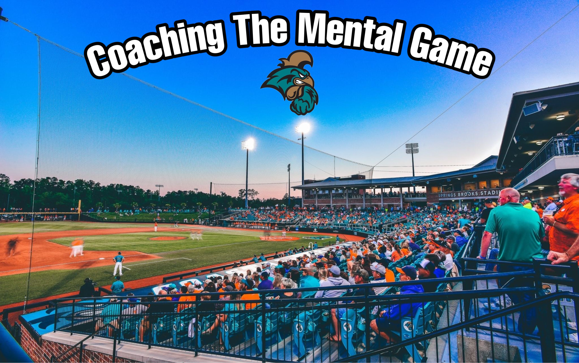

Slide 2
MENTAL SKILLS ARE A SEPERATOR
Every team in the country is getting better by practicing the skills they need on the field to be a better baseball player and team
Most coaches respond that the mental part of the game contributes to 80%-90% of a players success
Yet the % that actually coach the mental game is extremely low. In my opinion less than 10%
It is a way for less physically talented to level the playing field, teaching skills that not many others are focusing on.

Slide 3
IT ALL STARTS WITH THE COACH
Be an example for your players and demonstrate the qualities you want them to have
They are ALWAYS watching and listening. Especially in high leverage situations or when you hit adversity. Applies to in game or throughout the season. They learn how to deal with pressure by watching how their mentor and leader deals with it.
Teaching players to be solution oriented and not problem oriented. It’s easy to complain about and dwell on problems. How do we fix it?
Focus on having a growth mindset and the ability to improve through focusing on the right things and hard work.

Slide 4
Investing In Your Career – Prepare To Win
Hardest thing to teach young men in our instant gratification society is that over time consistently putting in work ends up making you a good player in the end.
No matter what the improvements in technology are, success will always be tied to hard work.

Slide 5
Eliminate Excuses
If I focus on what I can control there are no excuses.
Focus on evaluating yourself and your teammates will do the same. If everyone takes a look at what they can do better overall, in the weight room, on the mound, on a certain play, we are better as a team.

Slide 6
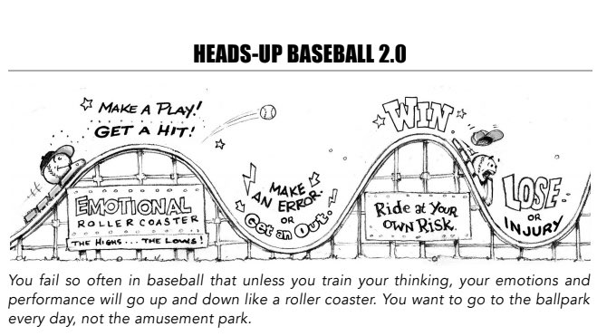
Avoid The Emotional Roller Coaster
Be the same guy when you show up each day
Don’t treat the players different based on good and bad performances
Help them realize that baseball is what we do it’s not who we are

Slide 7
Control What You Can Control
Can’t Control
Umpires
Weather
What people think about me
Coaches, Parents, Social Media, Friends, Teammates
Where and how hard they hit the ball
Errors
Field Conditions
Other Teams Chirping
Can Control
My mind and thoughts
My preparation
Where I throw the ball
What pitches I swing at
Fielding my position

Slide 8
Slow The Game Down
When tight situations occur or adversity hits, a normal reaction especially for younger players is to go harder and work faster, speeding the game up.
Teaching players to take a little more time in those situations is crucial
BREATH
Take the players through a breathing exercise and show them how it helps relax their muscles. Relaxed muscles move faster, which will help them perform.
Find a Focal Point
Flag Pole
Foul Pole
Kicking The Dirt Off the Pitching Rubber
Taking A Deep Breath While Looking At The Barrel

Slide 9
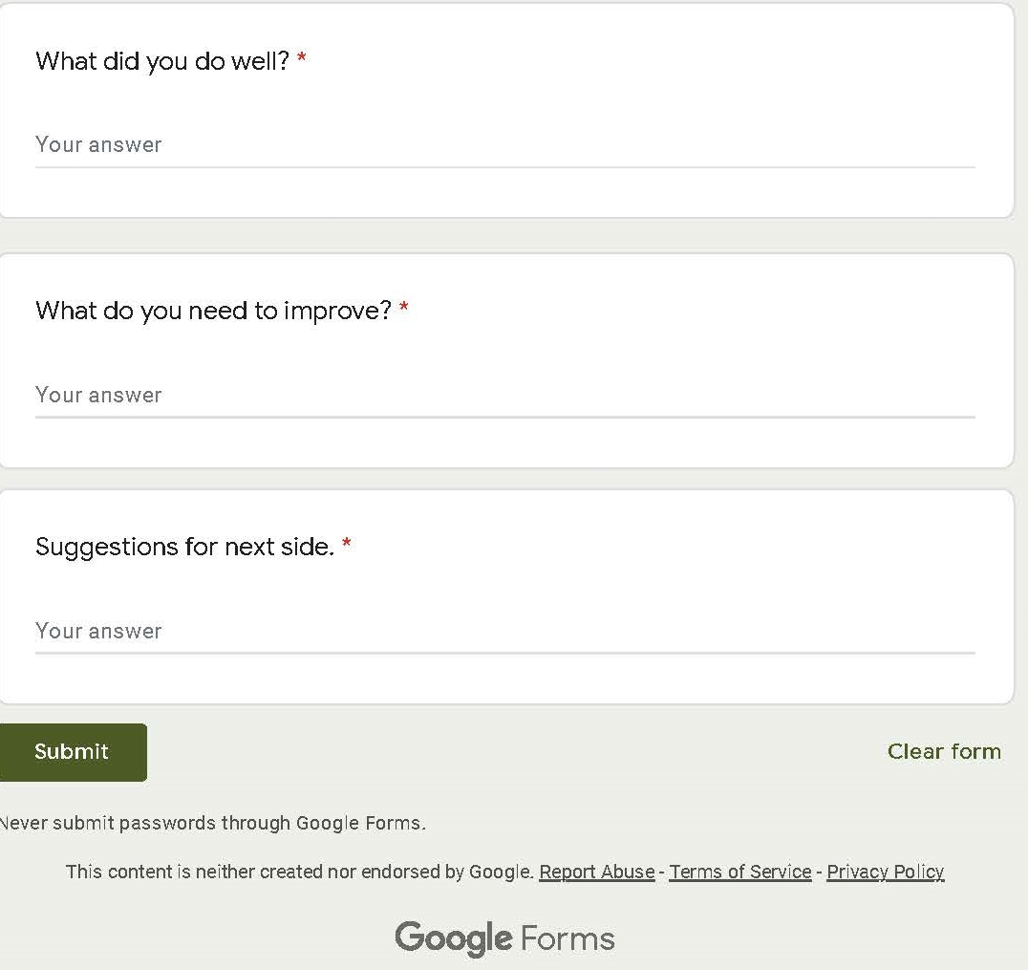
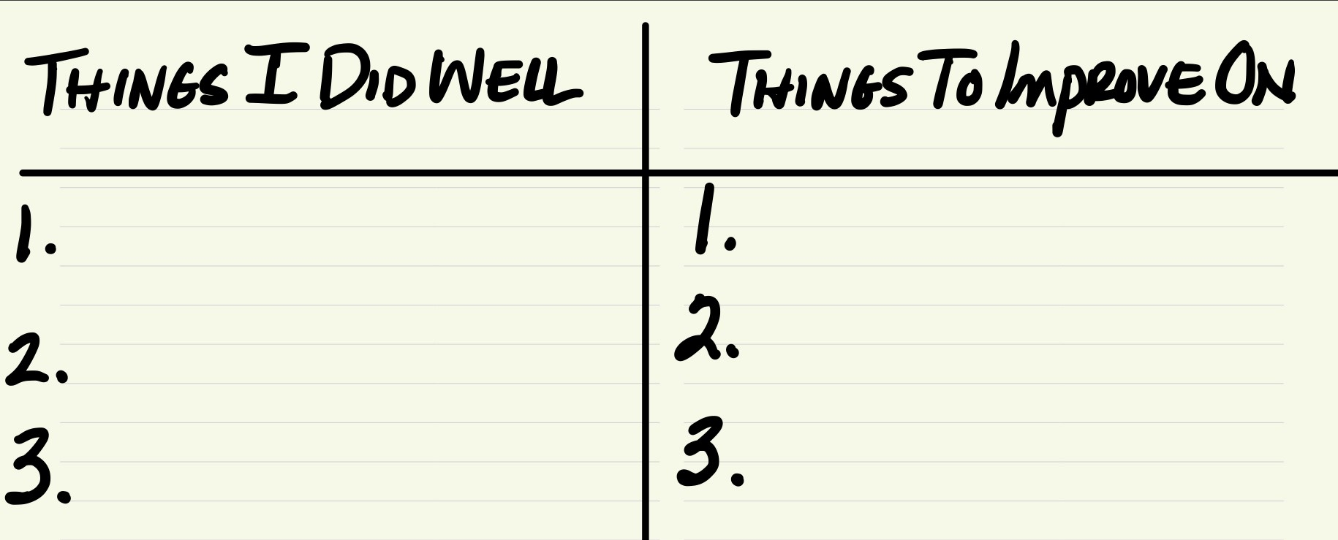
Honest Self Evaluation Is Key

Slide 10
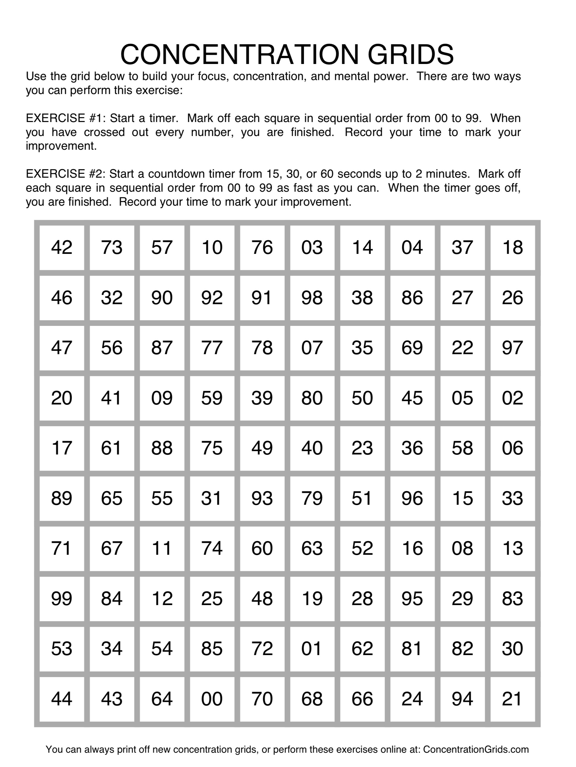
Mental Training Tools

Slide 11
Vision Tracking Exercises

Slide 12
Vision Tracking Exercises

Slide 13
Vision Tracking Exercises

Slide 14
Vision Tracking Exercises

